Slide 1
KULTURFORUM TURM
1

Slide 2
The project is located in Berlin, next to Postdamer Platz, in the Kulturforum. This gathers cultural projects with international prestige, like the National Gallery, Berlin’s Philarmonic, State Library, Science Center, Library and museum of Arts, Painting museum, music’s room, Decorative arts museum, Music Instruments museum and St. Mathew’s Church.
The site presents a disconnection between the projects that exist there (most of them master pieces of modern architecture). It is not evident either the relationship between the forum and its surroundings (Tiergarten, Spree canal and Postdamerplatz) Both situations are, at the same time, both the principal problem and the most important task to accomplish in this project.
Nevertheless, all the relations that we pretend to create or reinforce are clearer as one rises above the ground level. In other words, it is at ground level where the lack of perspective doesn´t allow the full understanding of its relationships, both existing and possible.
This project combines two main strategies: a ground level operation and a tower located over it.
The ground level organizes the visual tensions, the pedestrian connections and the circuit between the buildings through topographic interventions, pavement and green mass, which bring the presence of the surrounding parks within the center of the kulturforum.. The streets that now divide the area, are rebuilt at an underground level.
The tower allows the understanding of the complex geometry of the buildings in the site and also of the distant connections, beyond its limits. Its minimal footprint at ground level is conceived not to interfere in the perception of the buildings. The heterogeneity of Berlin’s morphology and the importance of the place allow the creation of this new vertical landmark.
We also a propose housing facing the park to activate the sector at all times.

Slide 3
Strengths
F
Buildings: Zone with the most important buildings in the city.
Location: located at the city center.
Equipment: principal focus of cultural equipment in the city.
Opportunities
Conectivivity: Diversity ways to transportate in between the city with the land. (bicycle, subway, bus)
Grass Areas: it is located next to a forest area (Tiergarten park)
Tourist landmarks: Near to the tourist focus (Brandenburg Gate, Holocaust Memorial, Reichstag building, Potsdamer Platz)
Water resources: Spoted rounded near water resources(Spree river, Urbanhafen river).
Heritage: the Kulturforum integrates one of the few heritage landmarks of Berlin; St. Mathew’s church.
O
D
Weaknesses
Space Distribution: Desconection between buildings and the surrounding area.
Ground use: It does not exist diversity neether good use of the ground.
Users Flow: Because the area doesn’t have residencial buildings near by, the people flow cosiderable reduces at the night time.
A
Threats
Program failed: Independence between buildings.
2

Slide 4
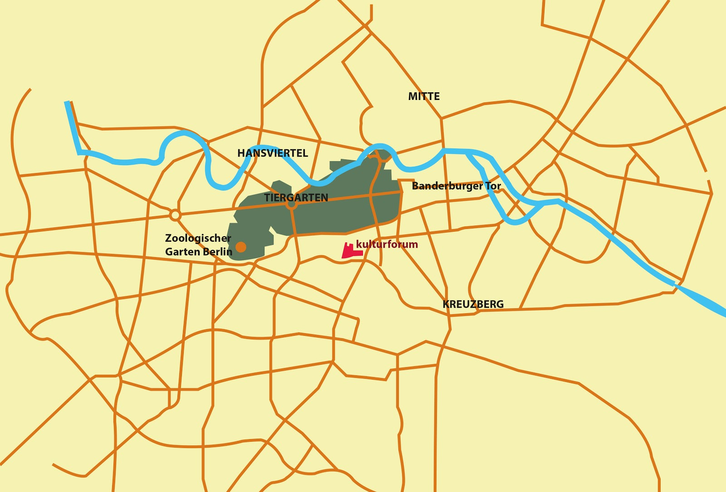
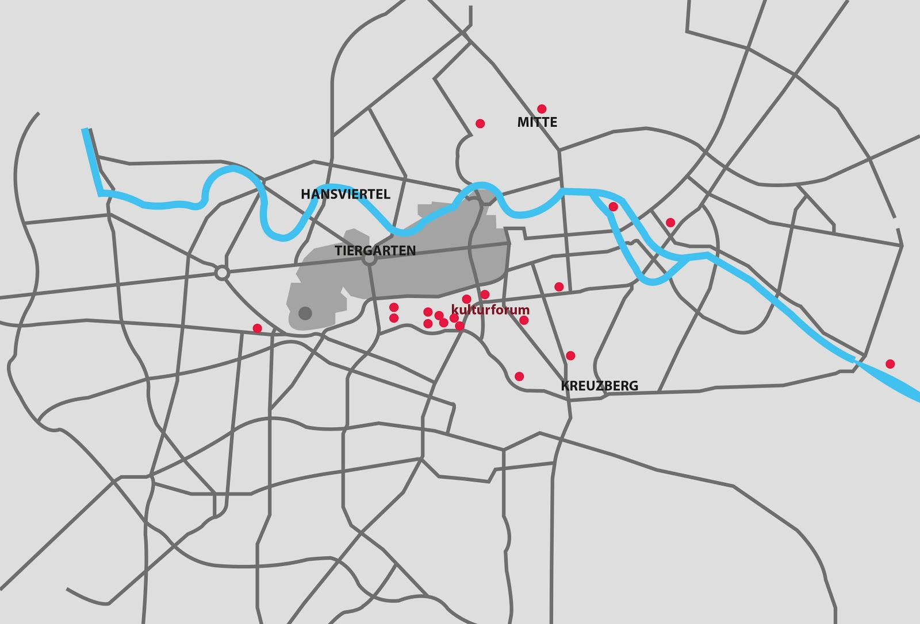
Central Location
High concentretation of landmarks
River
Park
Hitos
River
Park
3

Slide 5
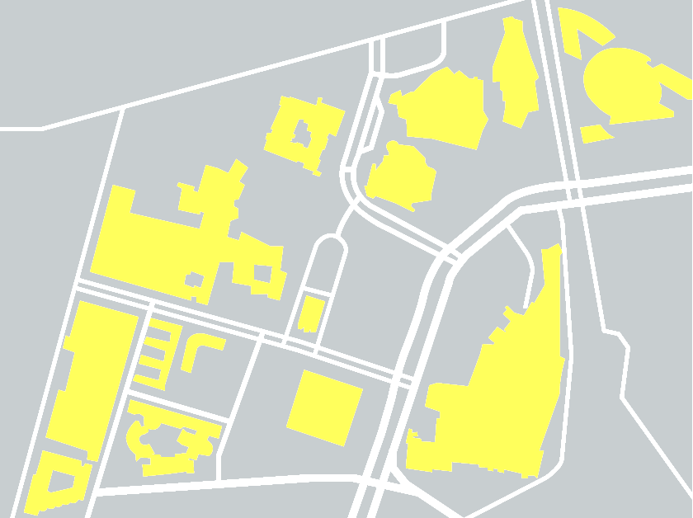
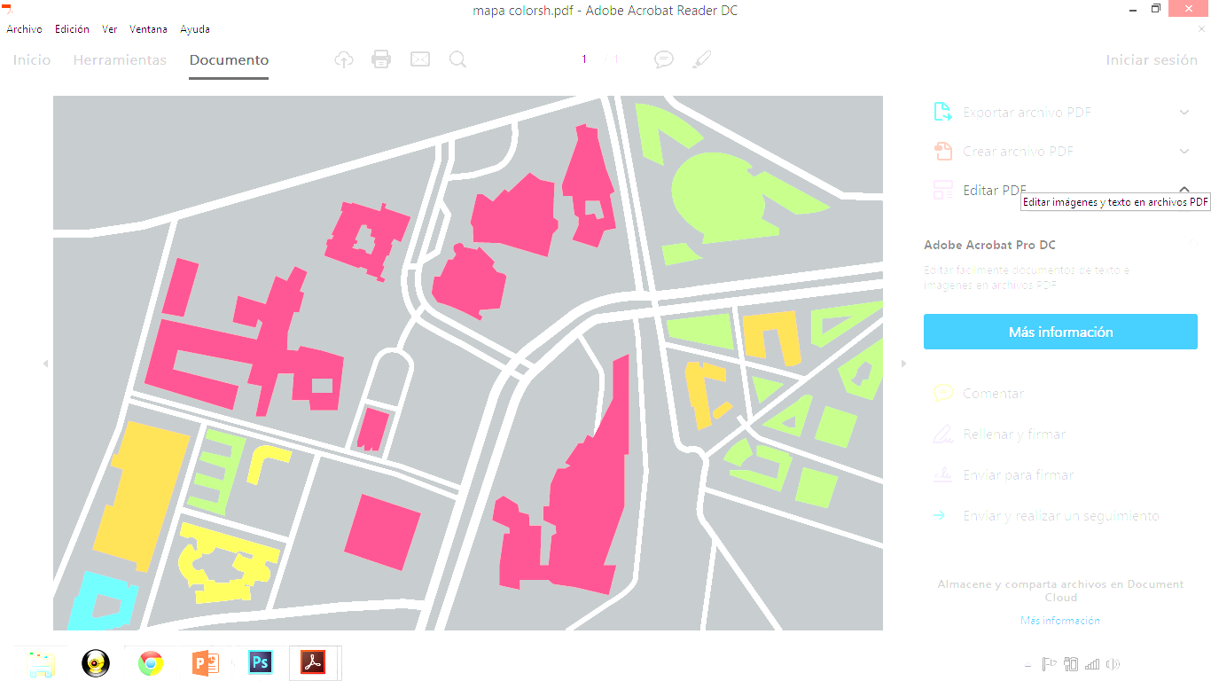
Space distribution
Ground use
Buildings
Public Space
Trading area
Cultural
Educational
Housing (hotel)
4

Slide 6
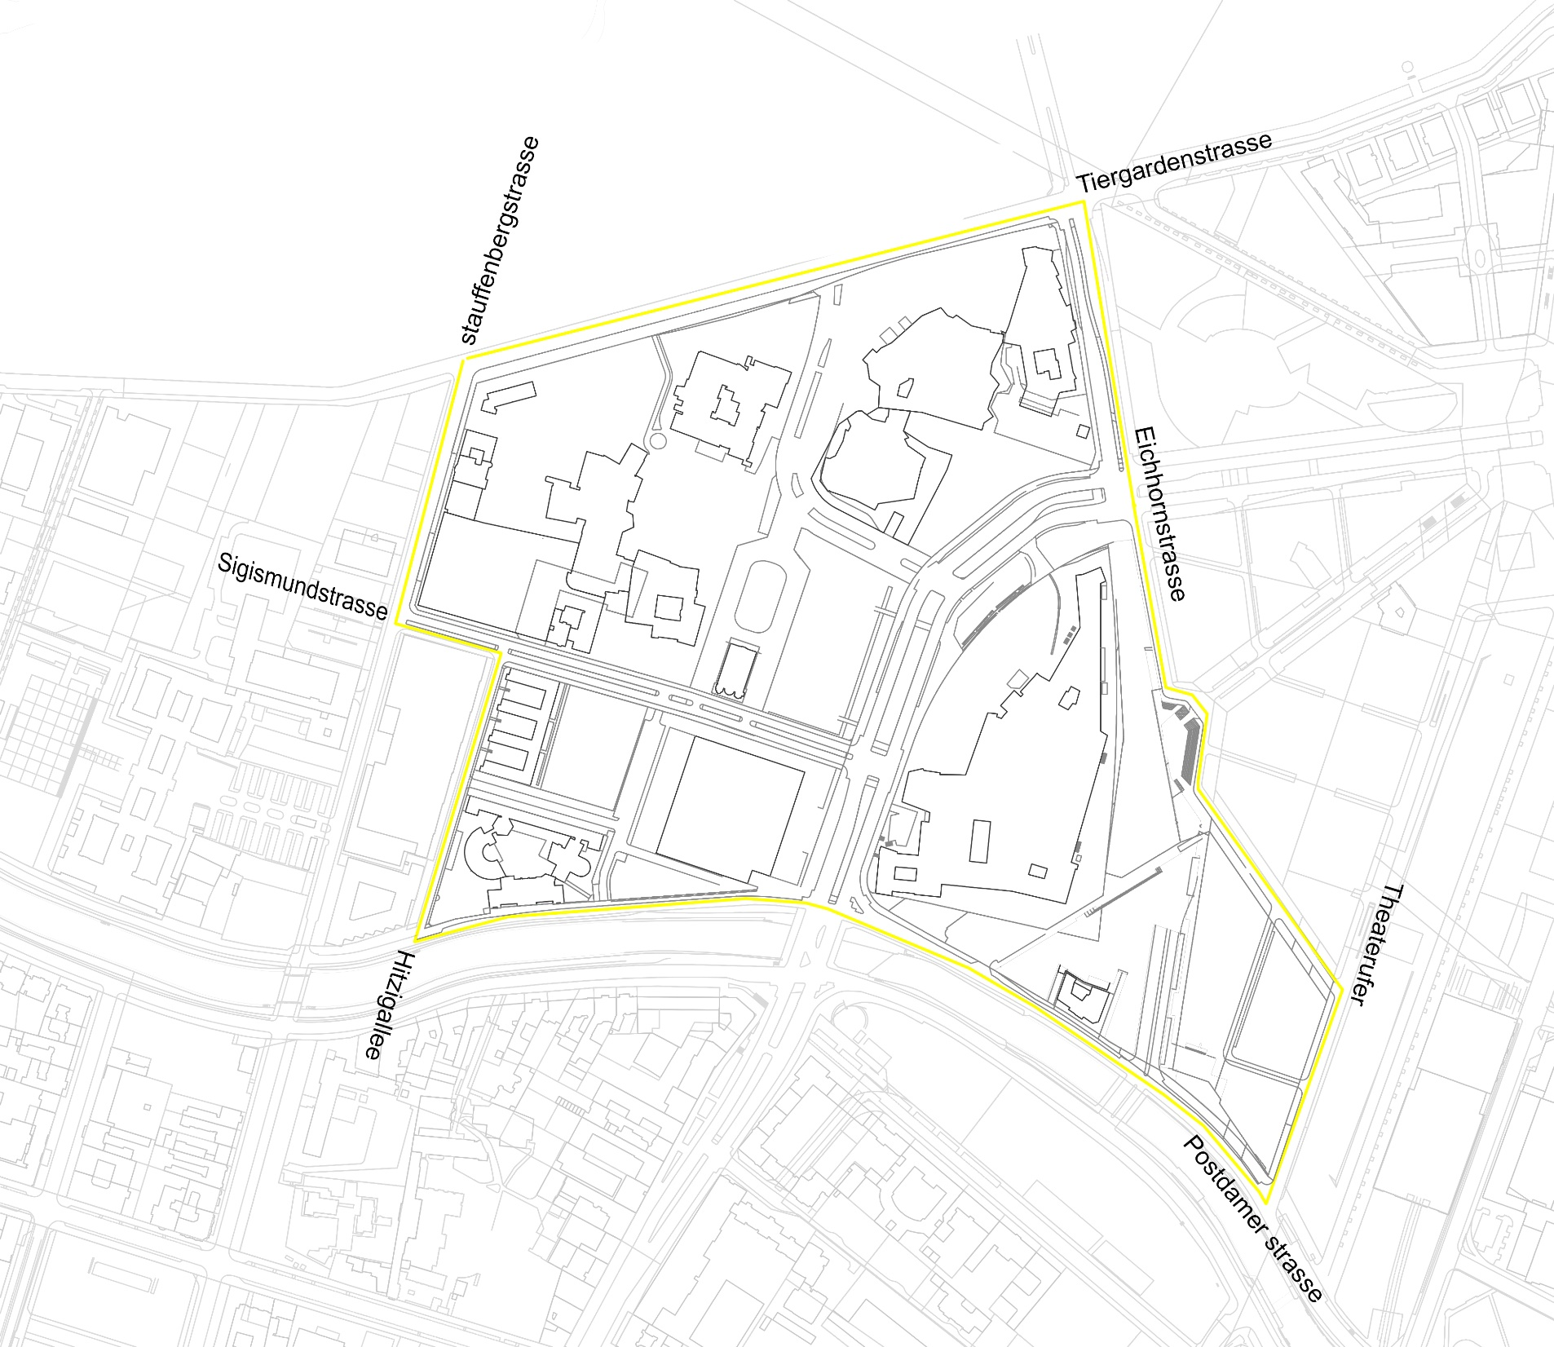
CONTEXT
Limiting streets
5

Slide 7
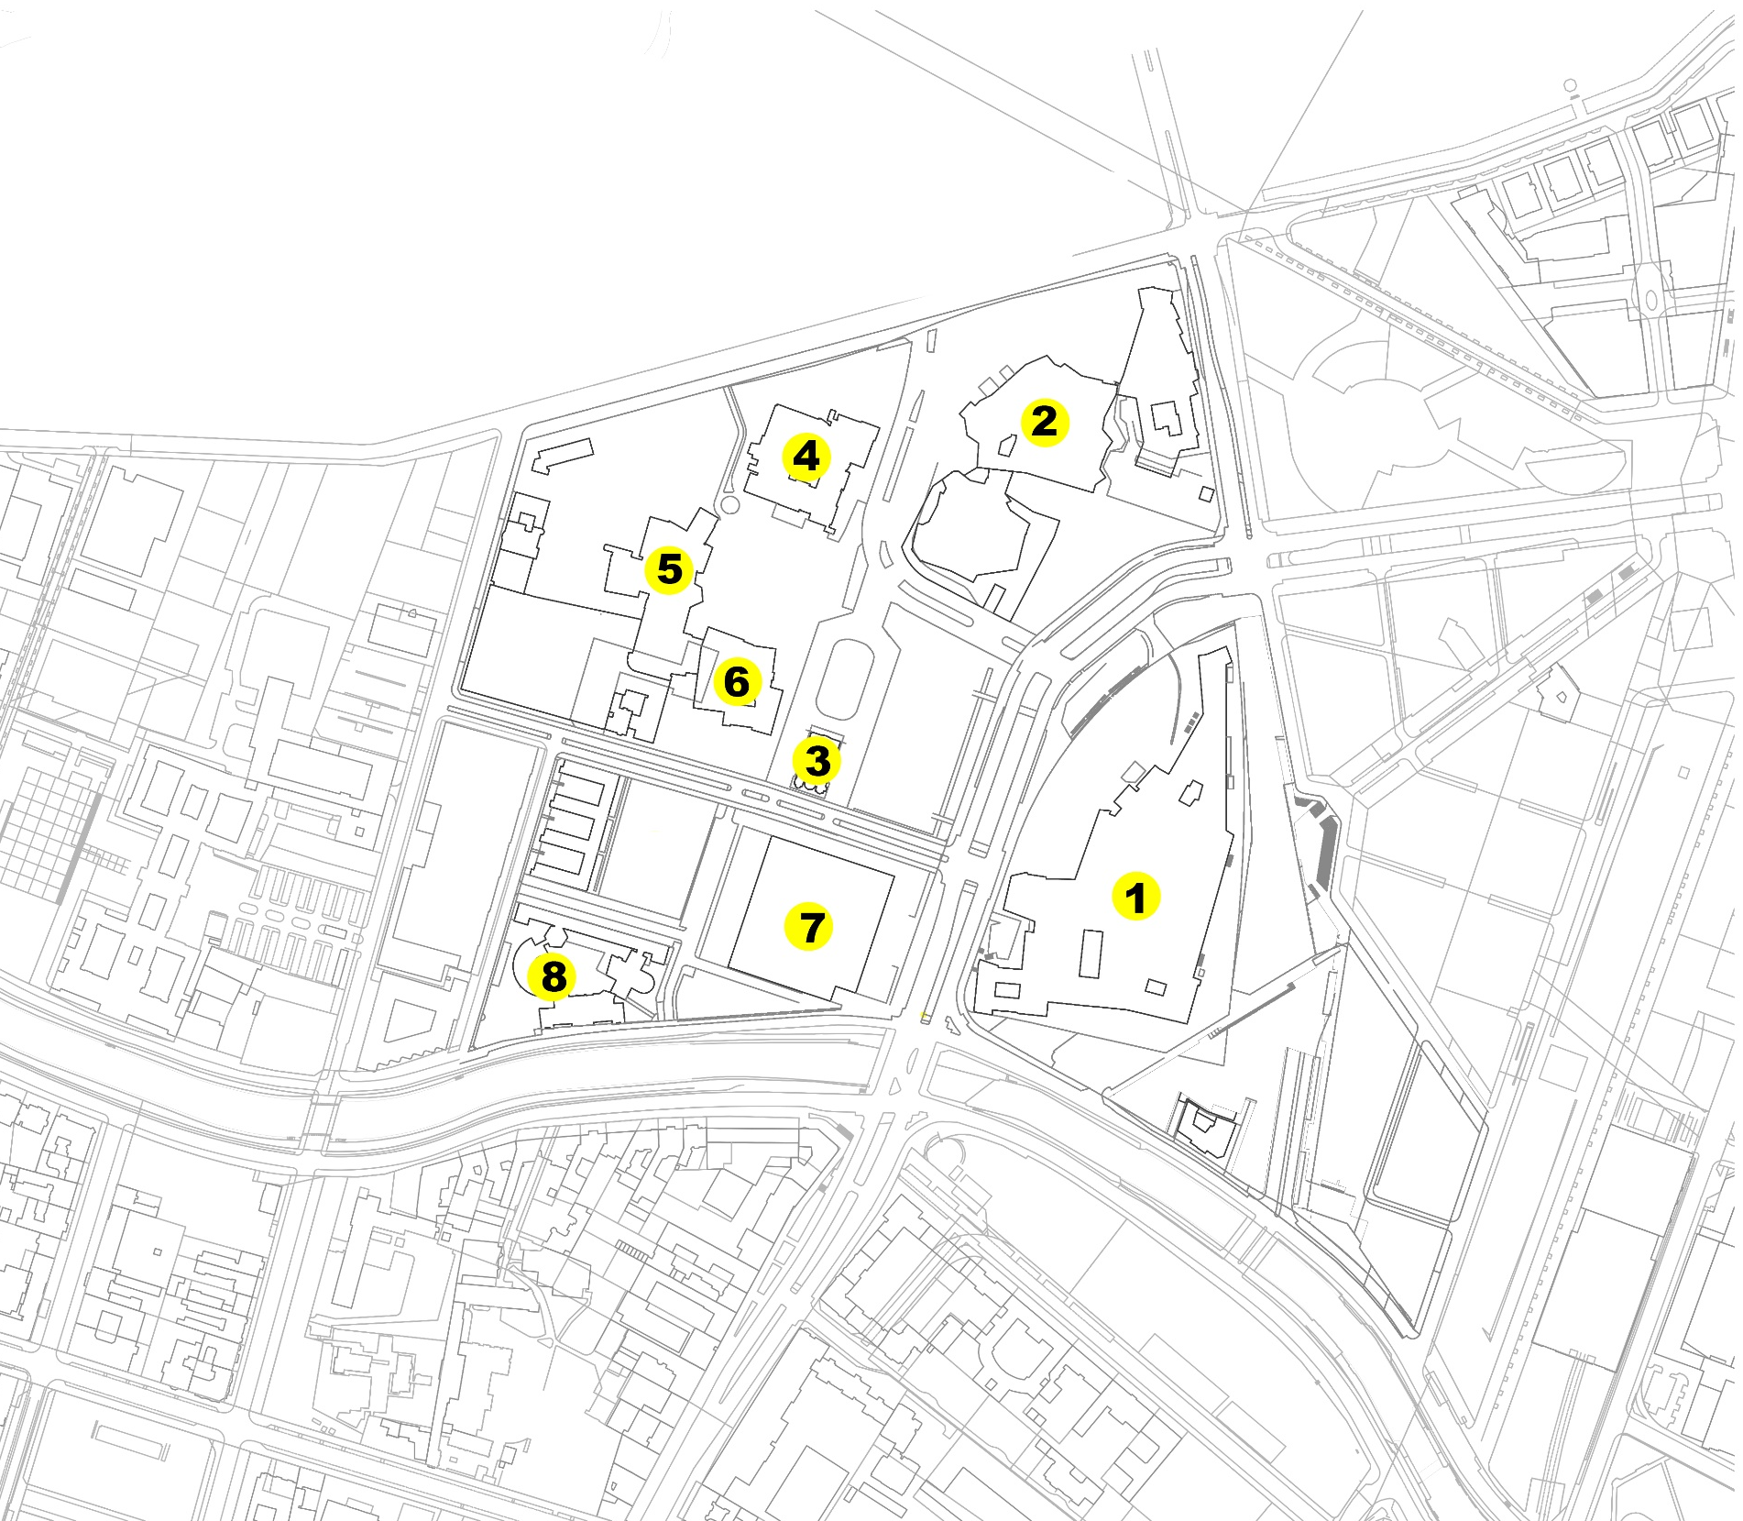
BUILDINGS KULTURFORUM
State library
Philarmonic
St mathew´s church
Museum of decorative arts
Museum of graphic arts
Art library
National Gallery
Science center
6

Slide 8
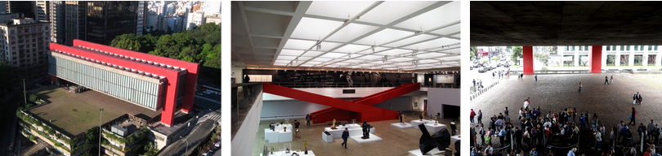
References
MAPS
Lina Bo Bardi
The constitution emptines of the dry park and the entrance hall, take importance in the Project. This unite the both sides of the bulding with the city.
7

Slide 9
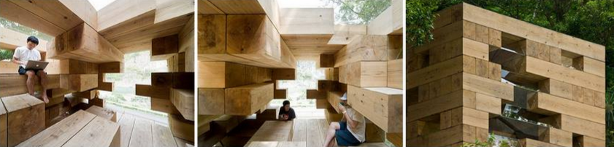
Referentes
Final Wooden House
Sou Fujimoto
The constitution of the Wood, make sections of this material, in the inside of the outgoing romos or entrance., transform the spaces to sit down, laydown or go up. Been the bays a consecuence of the order of this elemts like configurations of the space.
8

Slide 10
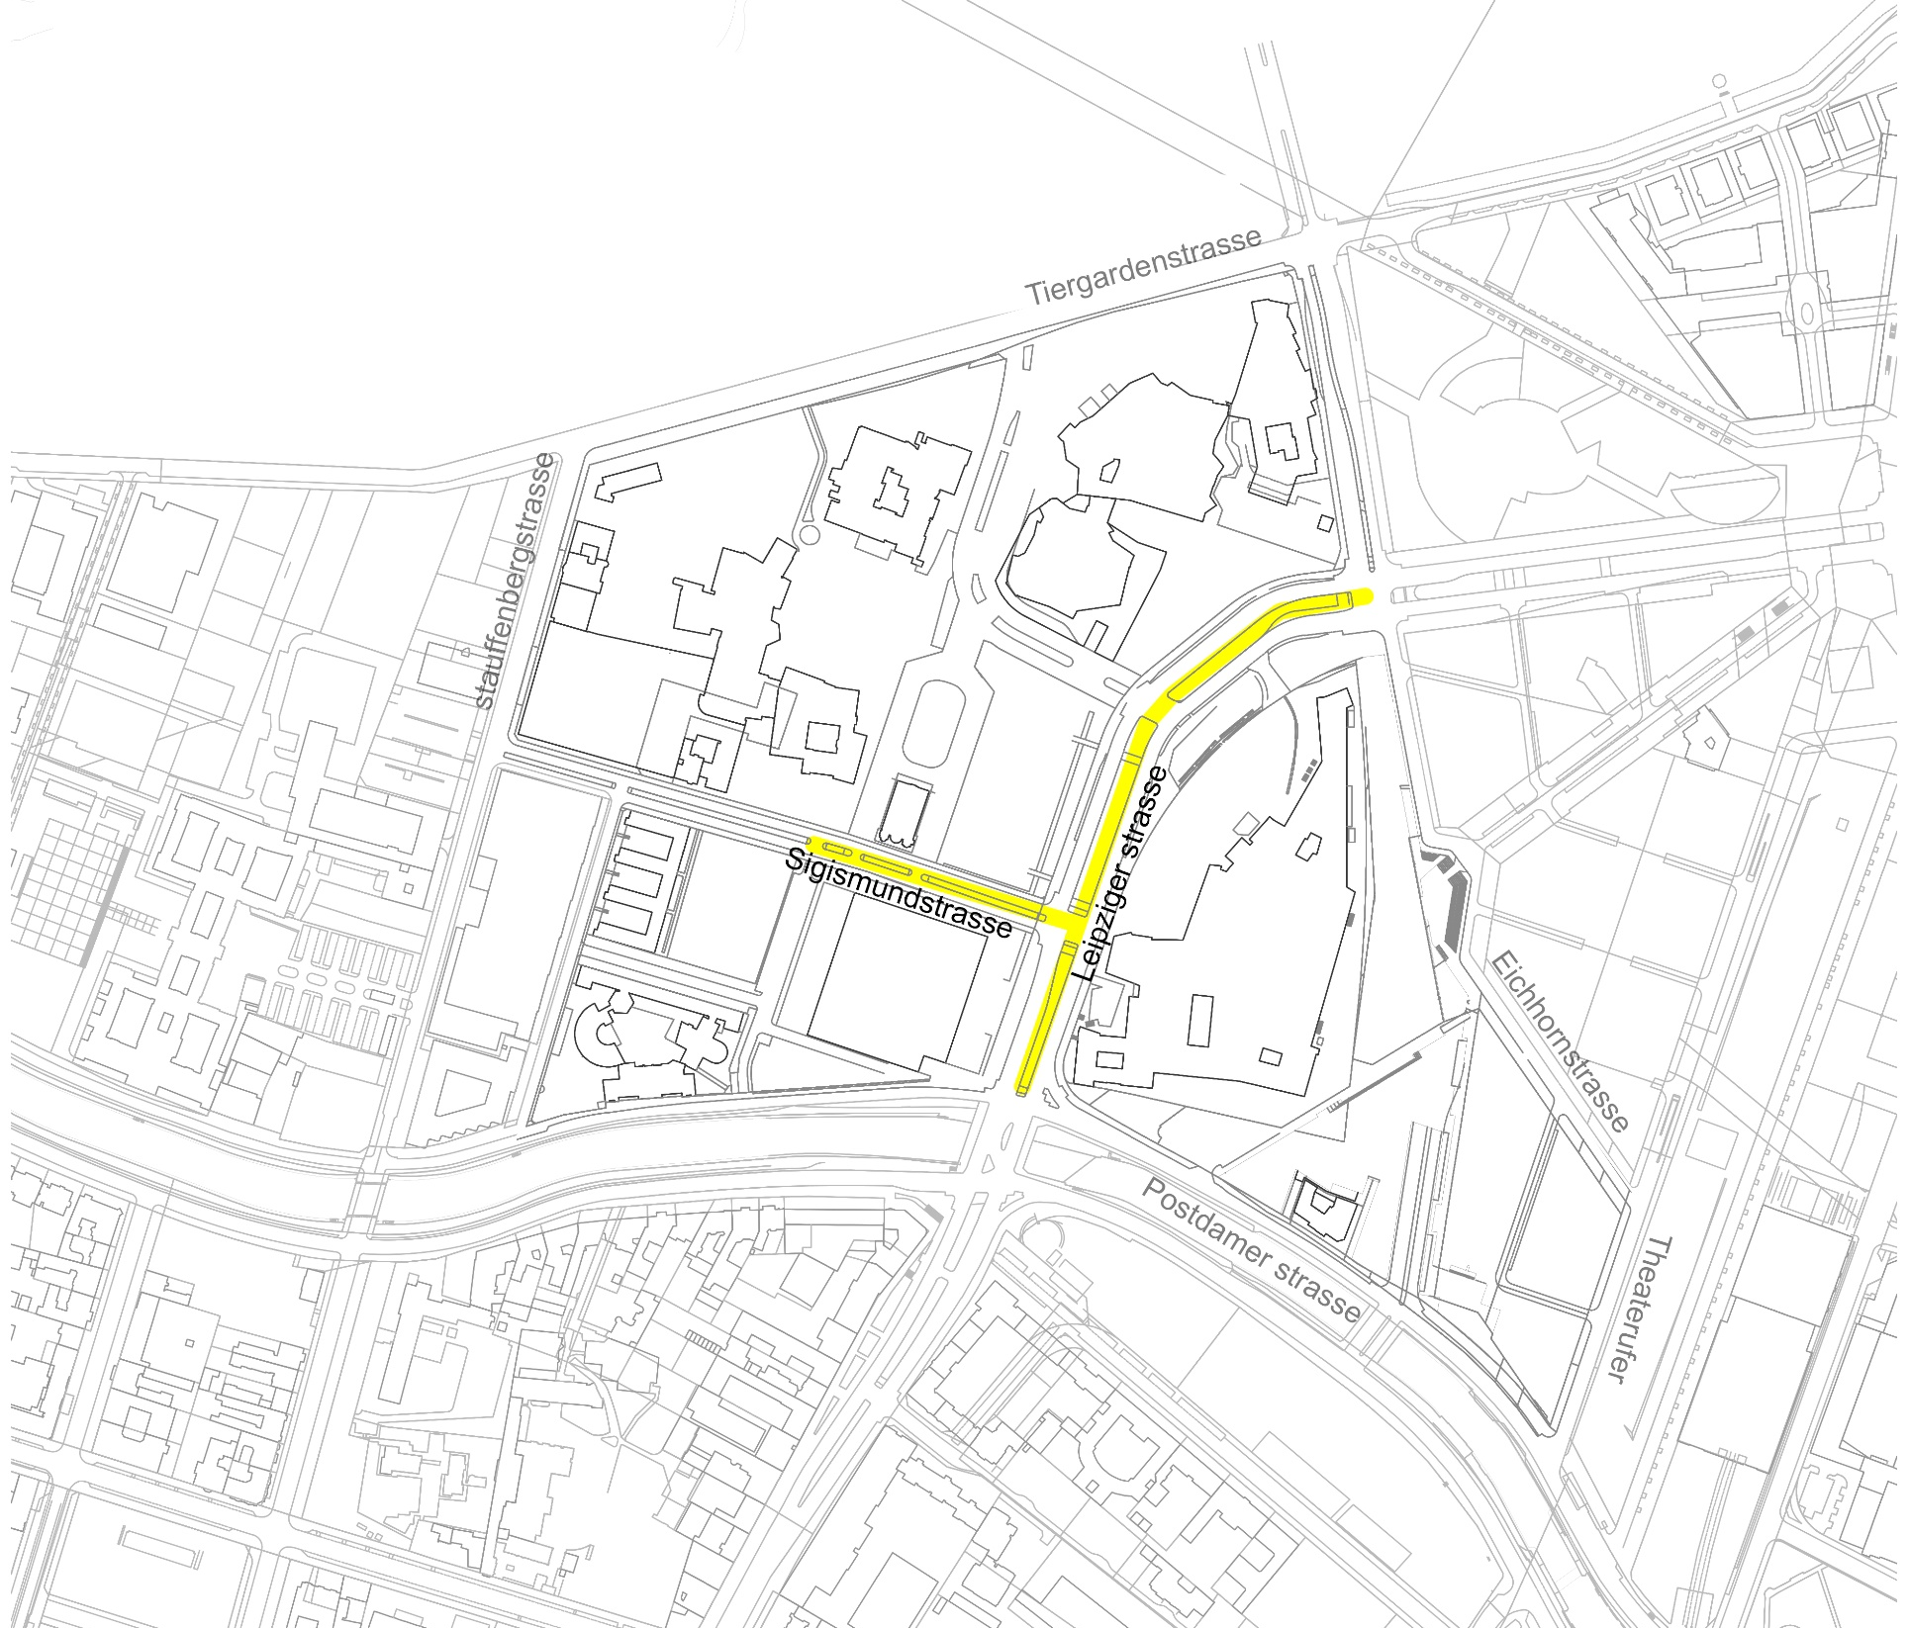
1) Grounded avenues Sigismundstrasse and Leipzigerstrasse on the kulturforum lenghts
9

Slide 11
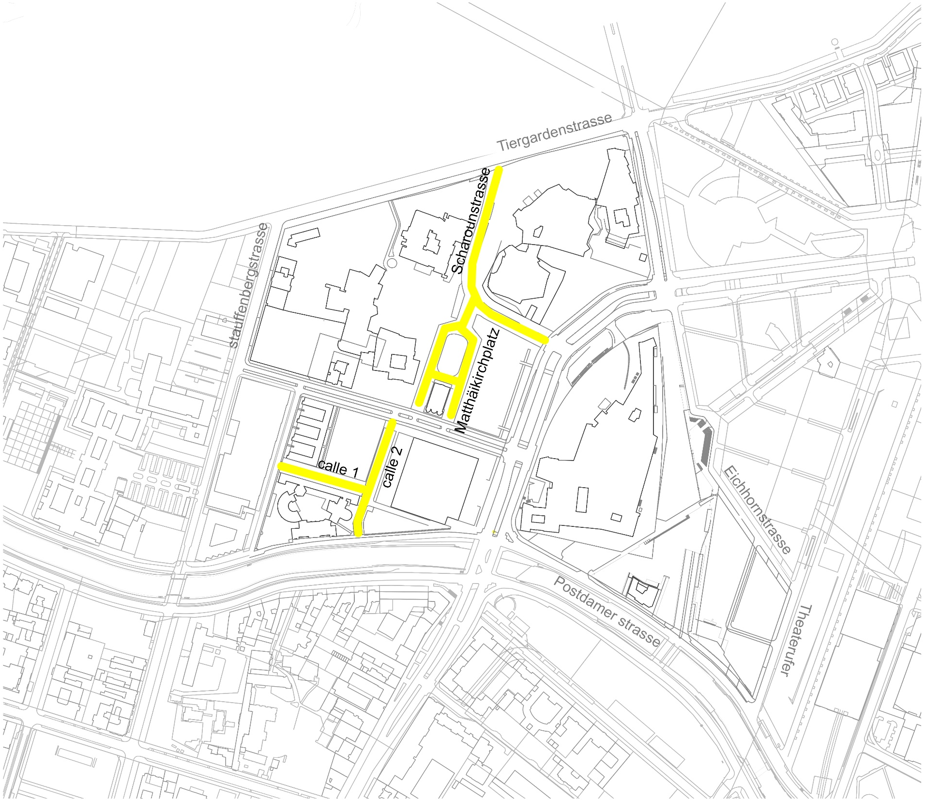
2) To remove the car roads of the small sizes
10

Slide 12
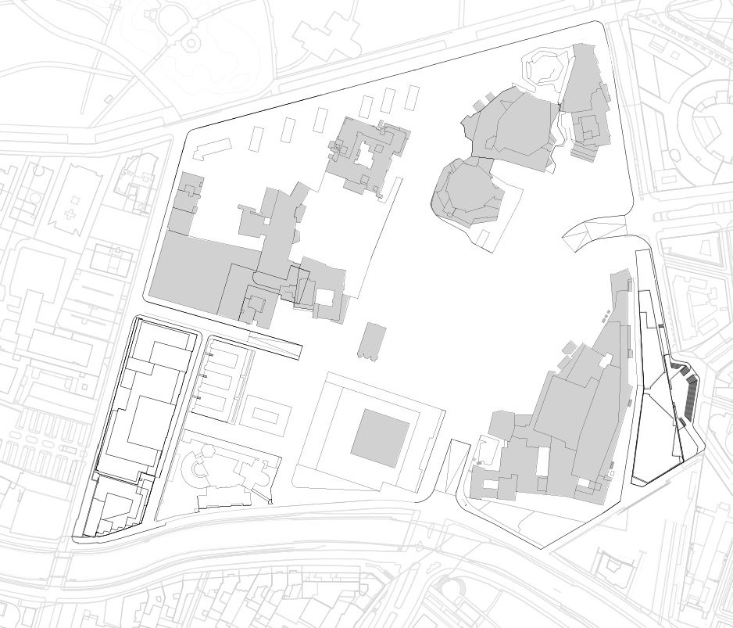
Tiergardenstrasse
Continuos floor
Eichhomstrasse
Struffenbergstrasse
Postdamerstrasse
11

Slide 13
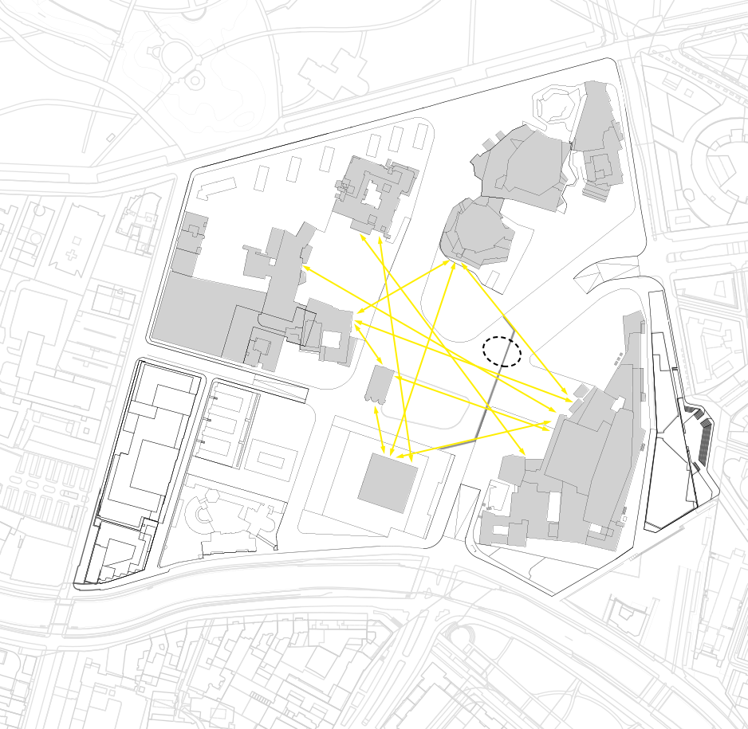
3) To Place the volume area, according to the visual relationships
Visual relationships
Project (146 m2)
12

Slide 14
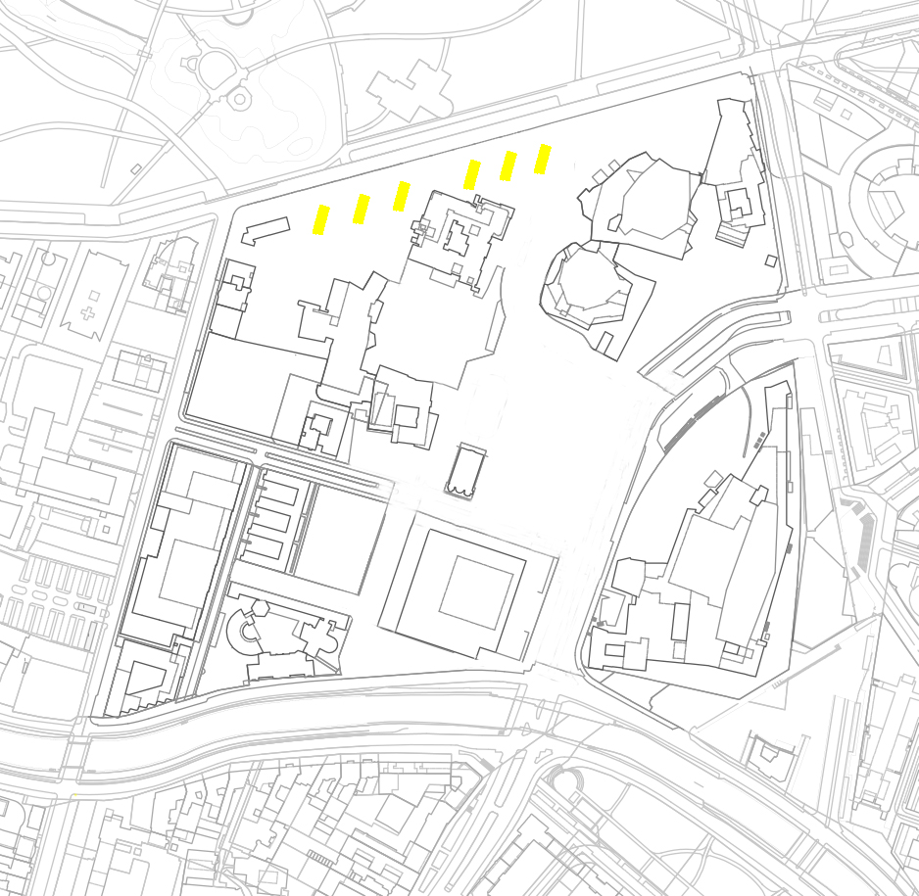
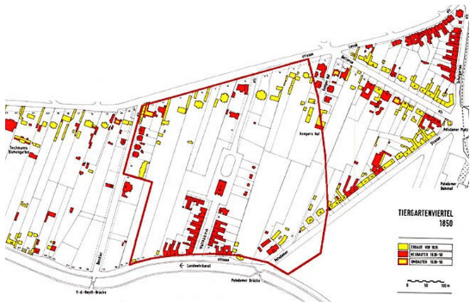
To buil a facade in front of the Tiergarden park.
Keeping the line of the 1850 ground subdivision , at the same time the irrigation channels direction.
13

Slide 15
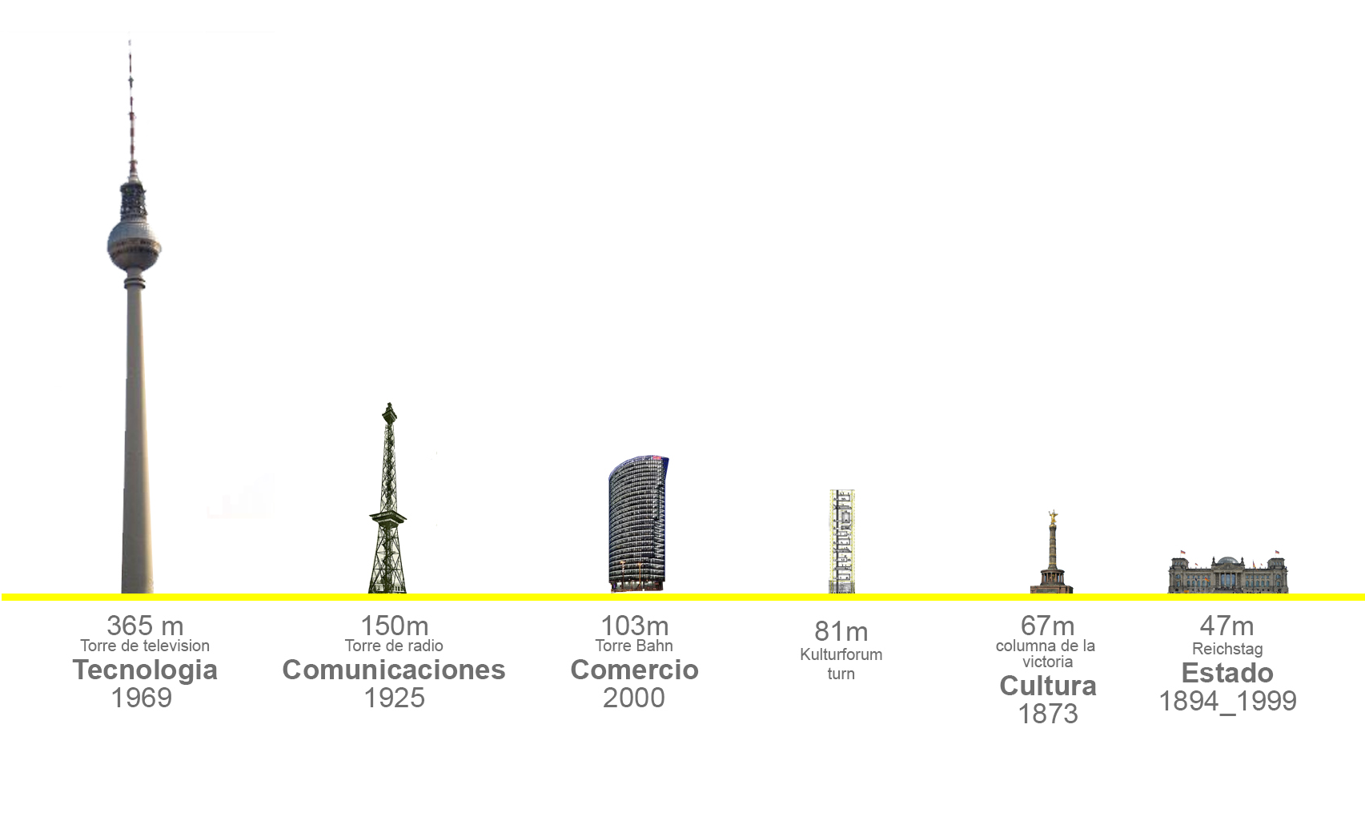
5) The differents highs between the landmarks
14

Slide 16
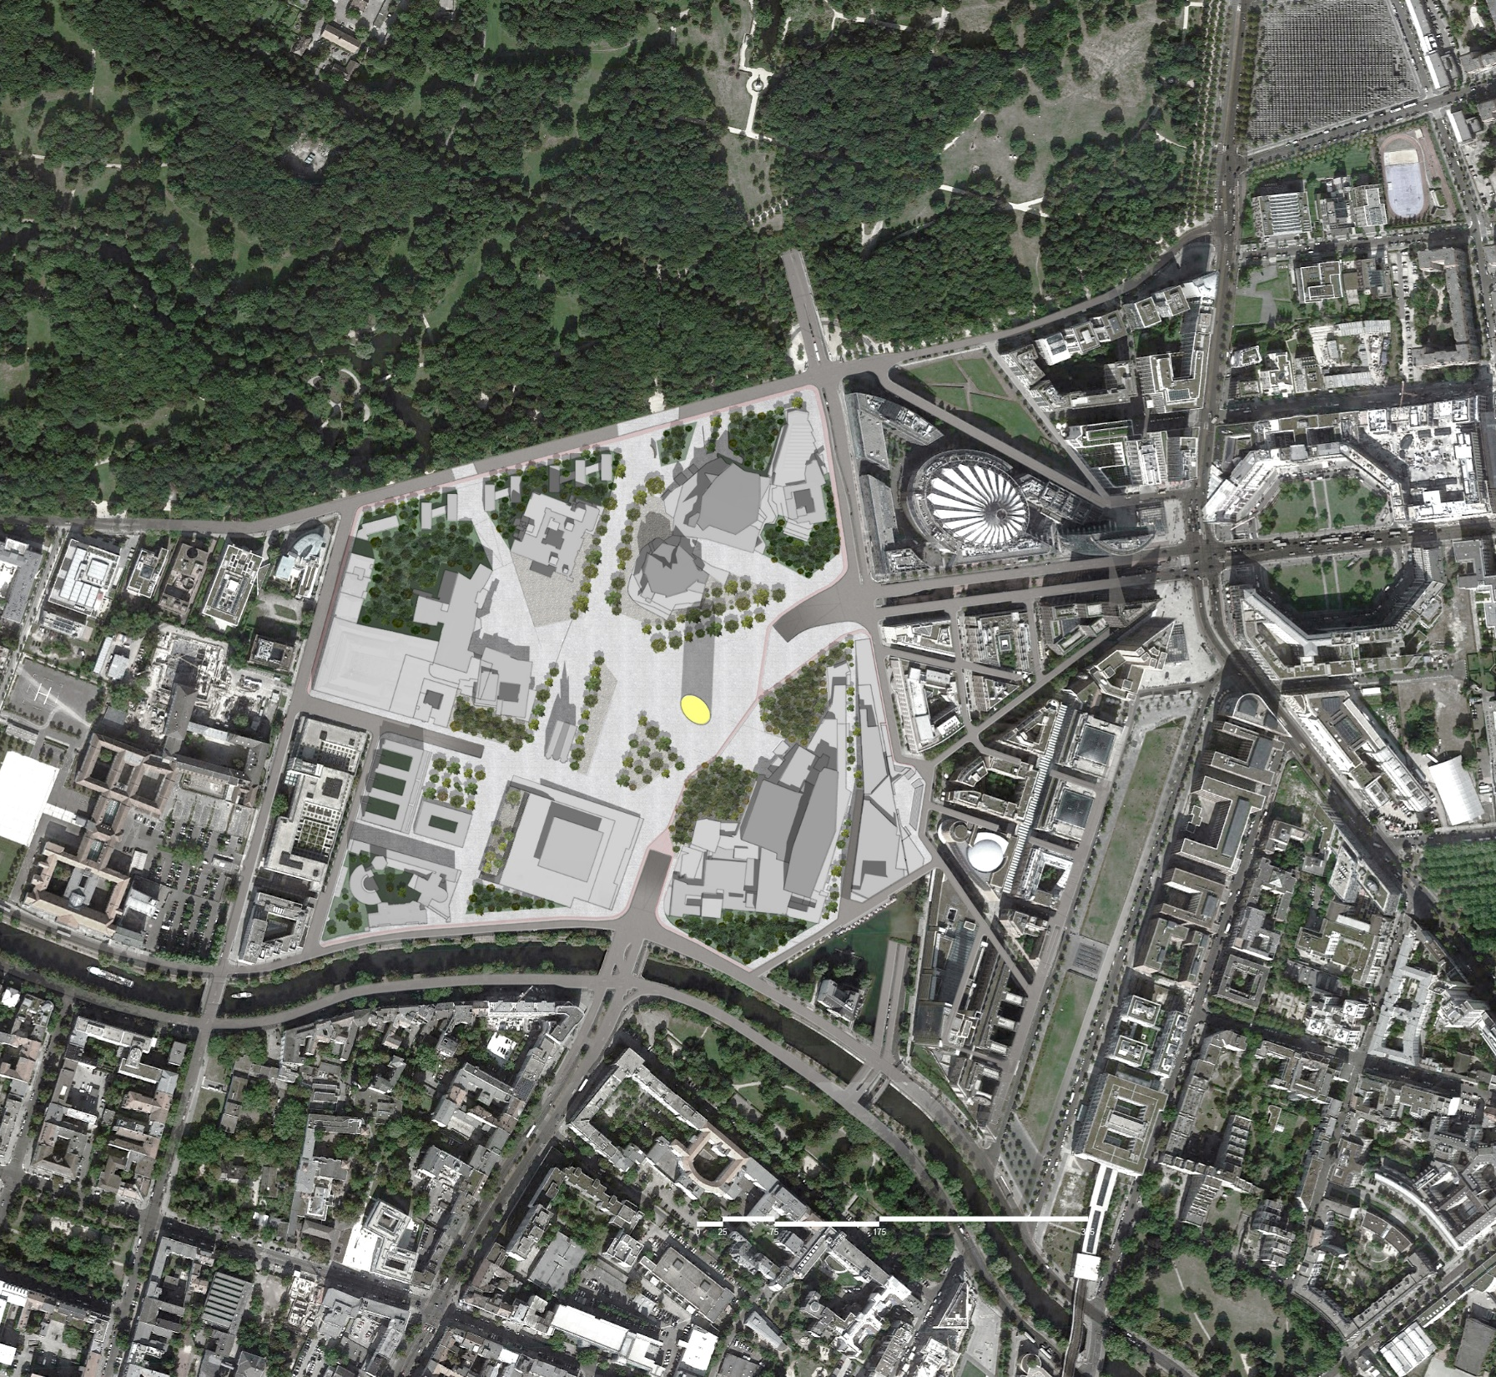
New Project
Existing Projects
7) To Intervene the ground and existing pavement, to connect the projects.
15

Slide 17
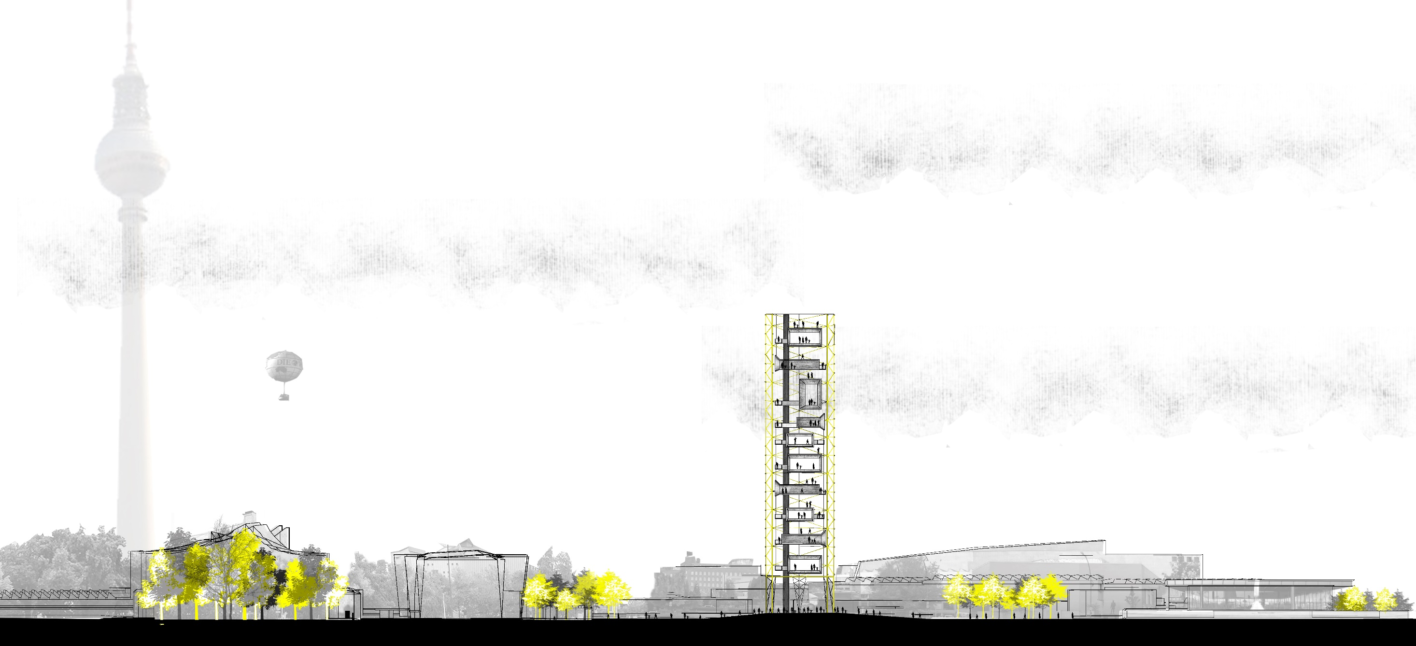
15 A

Slide 18
15 B

Slide 19
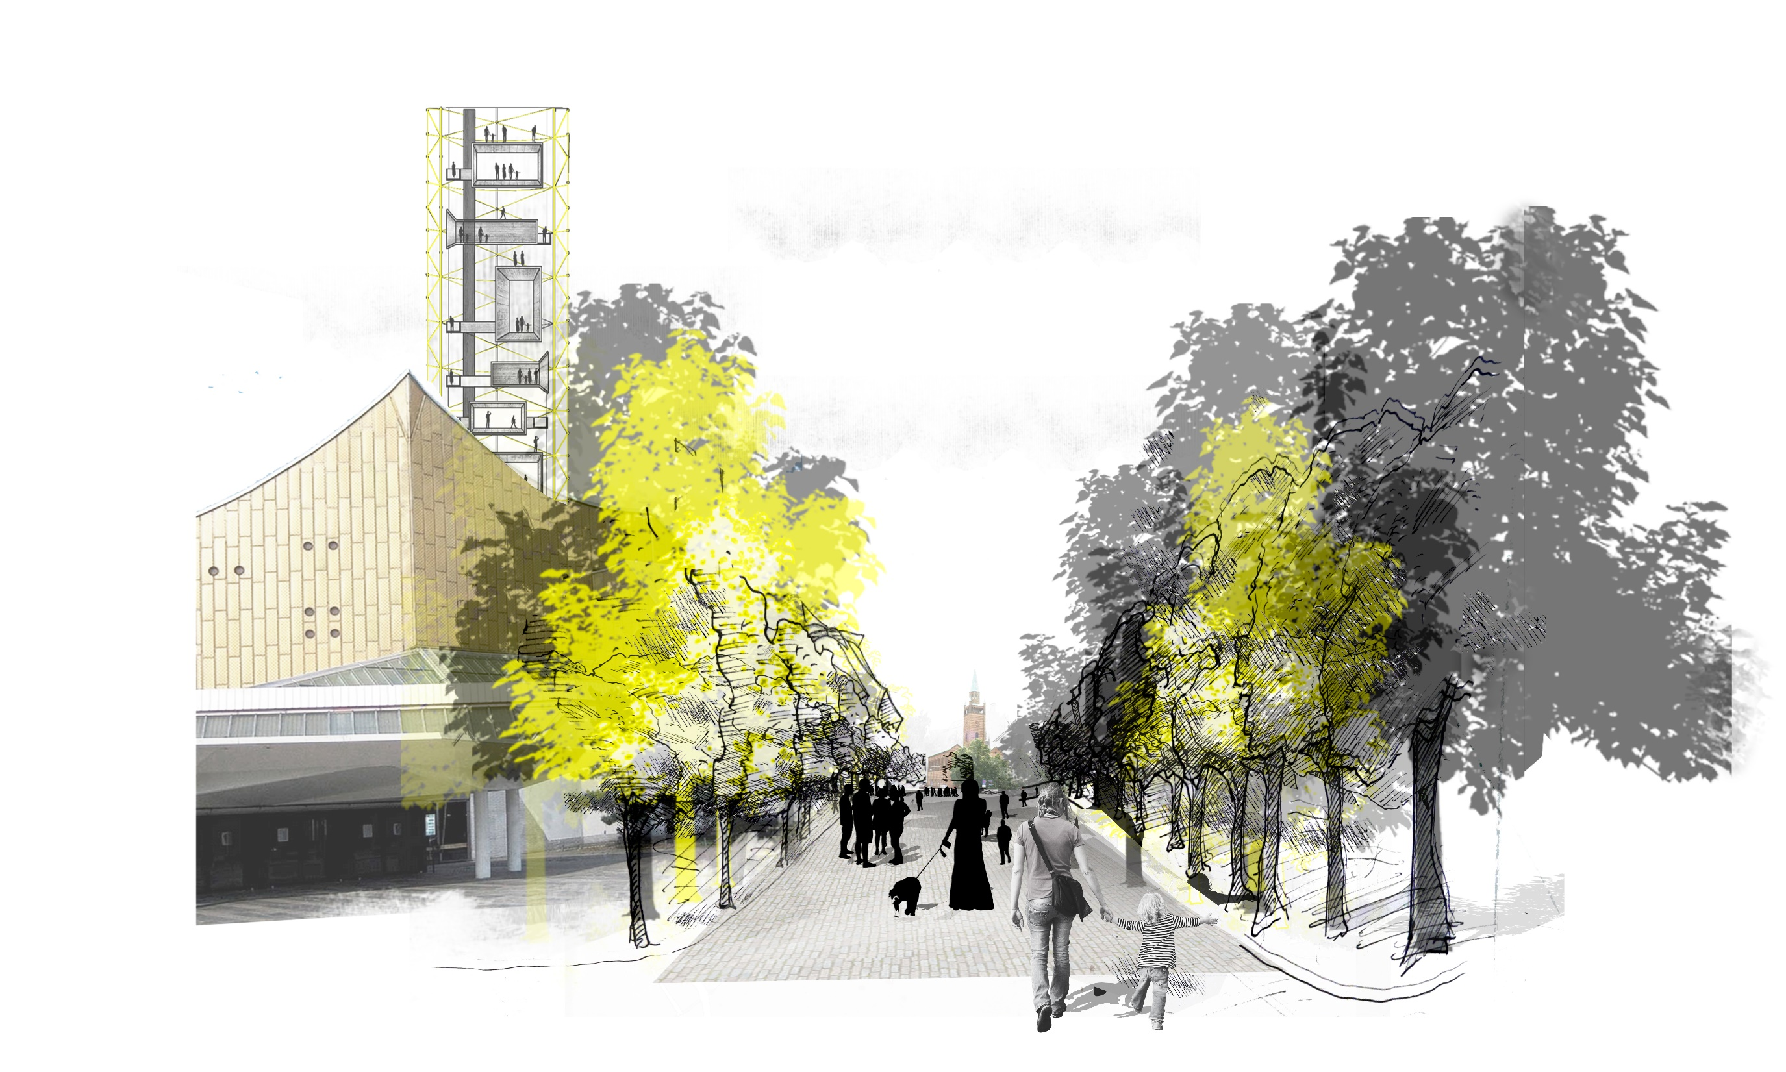
16

Slide 20
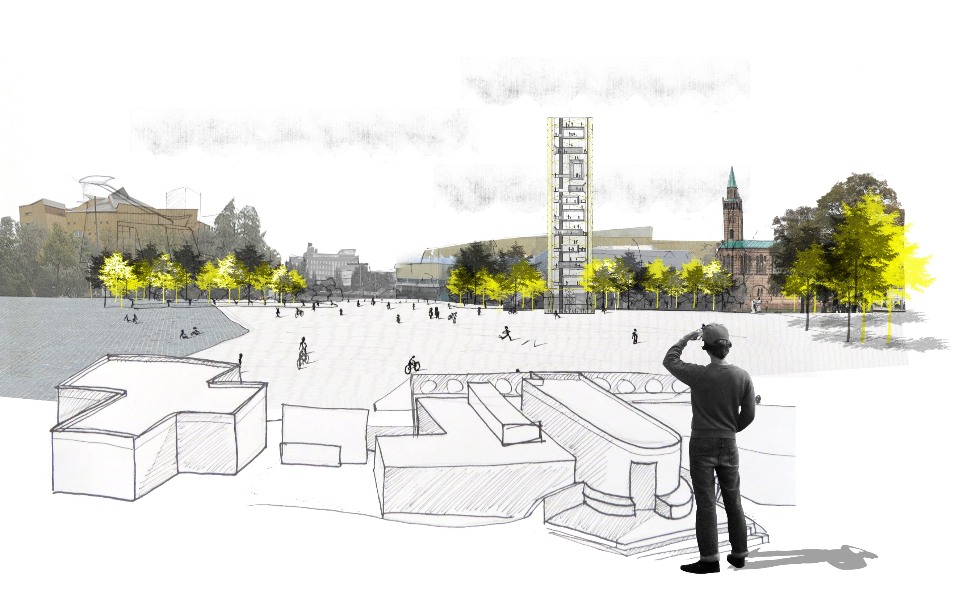
17

Slide 21
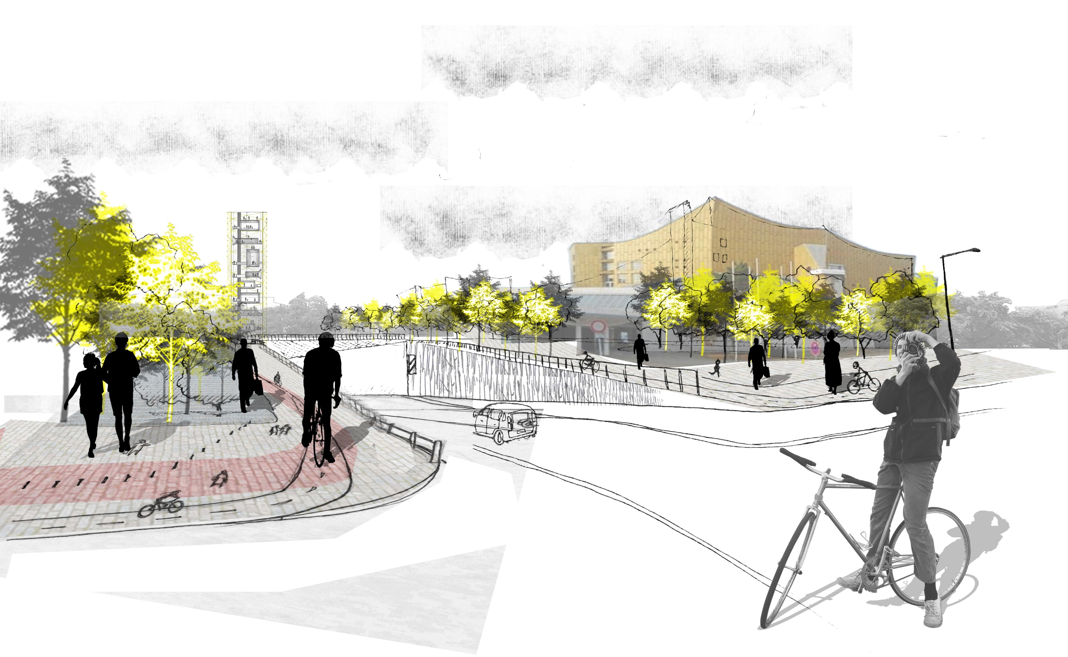
18

Slide 22
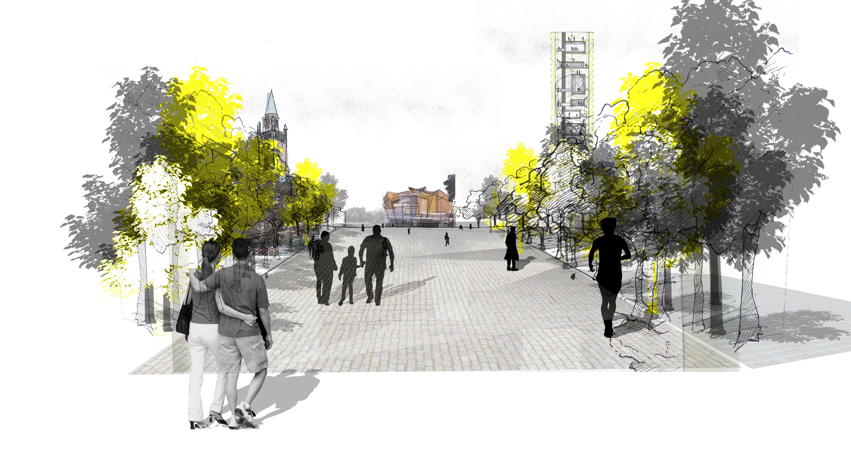
19

